Slide 1
Deployment

Slide 2
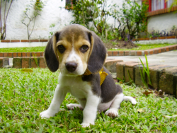
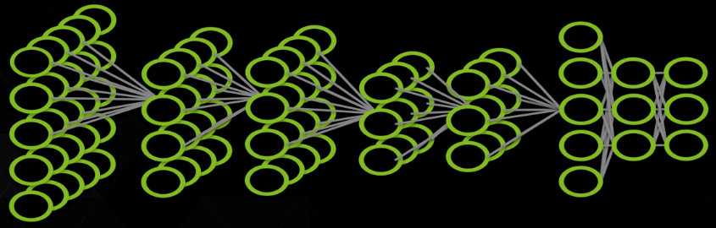


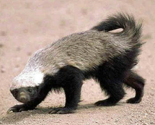

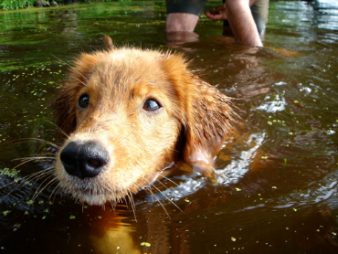
Deep Learning Approach
Train:
Errors
Dog
DNN
Dog
Cat
Raccoon
Cat
Honey badger
Deploy:
DNN
Dog
Notes:
Once the DNN has been architected, then it is time to build the model.
The model is built using training images that have labels provided
These images go through the DNN and receive a classification value that can then be compared to provided label
The training phase also involves calculating the loss (difference between correct value and predicted value) and then uses backpropagation to adjust the weights in an attempt to make
more accurate predictions
The end result of the training phase is a model that can then be used to make predictions on images the computer has never previously seen before

Slide 3
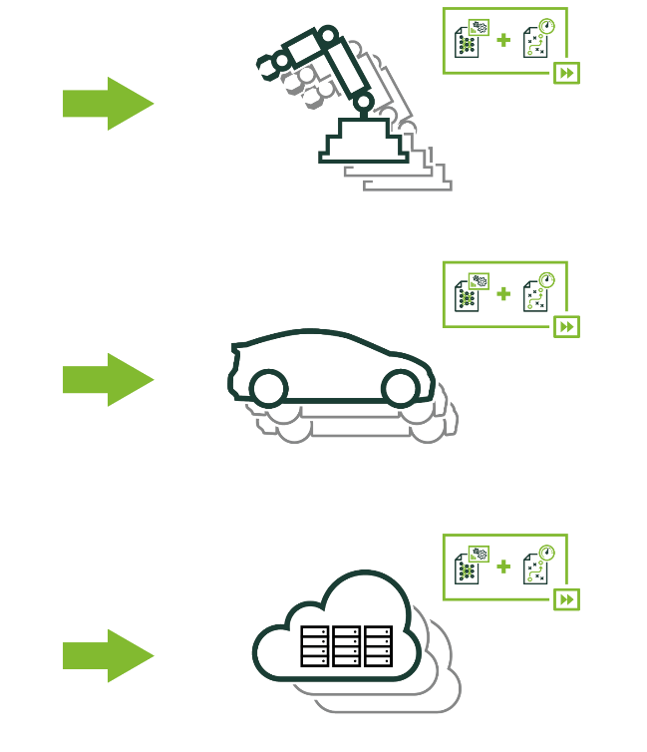
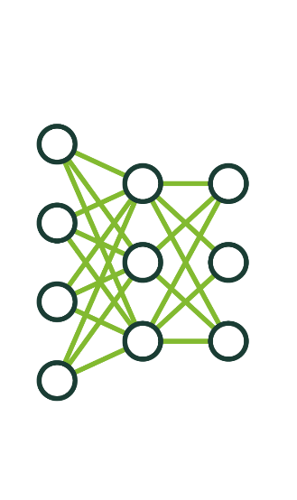
Deployment
How do I use a trained neural network as part of a solution?
Notes:
What is deployment?
We already know that deep learning allows us to solve problems that we’ve never before been able to. The question that we’ll approach in this lab is: how do I solve a problem using a trained neural network as part of my solution?
For example:
How do I deploy an image classifier to an iPhone app that can tell me whether or not a plant is poisonous?
How do I deploy a pedestrian detection model to a self-driving car to adjust the car’s speed?
How do I deploy a speech recognition tool to a piece of hardware that can authorize purchases?
While there is often a lot of work to be done to train the neural network, this lab assumes we have a trained network and will teach how to now apply it.

Slide 4
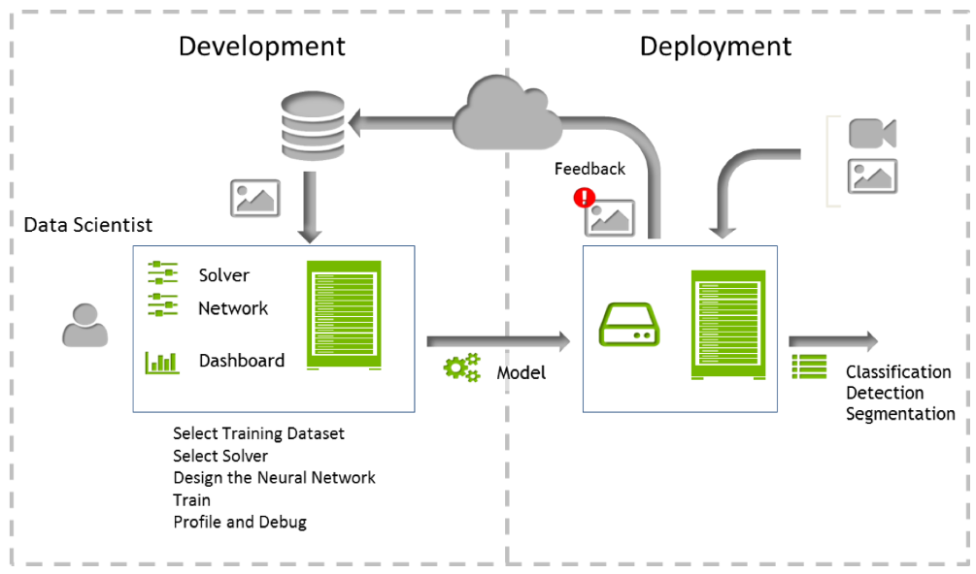
Deep Learning Approach
Neural network training and inference
Notes:
The next step – inference – uses the trained model to make predictions from new data. During this step, the best trained model is used in an application running in a production environment such as a data center, an automobile, or an embedded platform. For some applications, such as autonomous driving, inference is done in real time and therefore high throughput is critical. The typical training and inference cycle is depicted below.

Slide 5
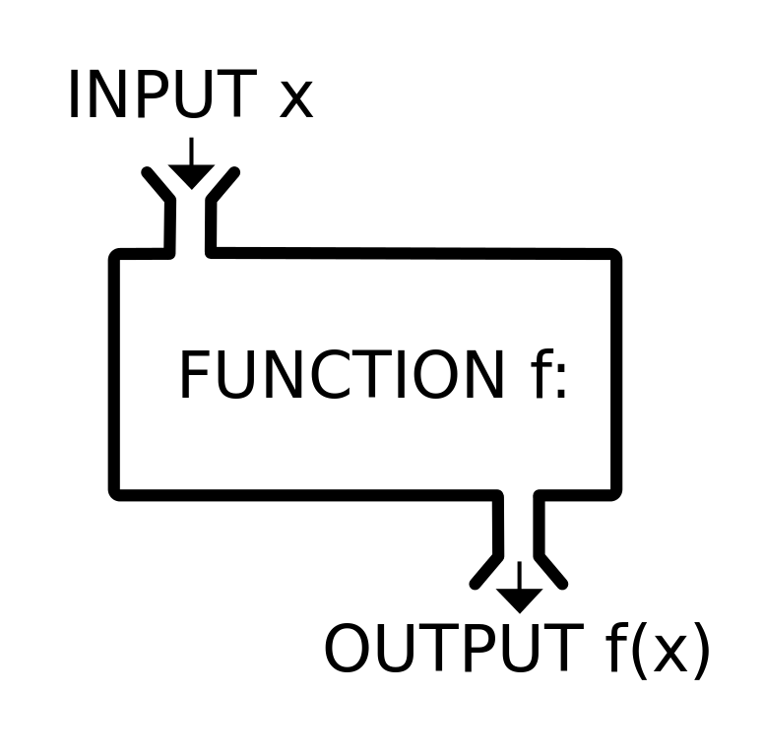
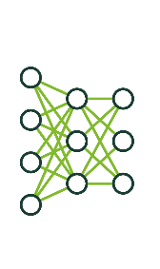
Expected Inputs and Useful Outputs
Notes:
It’s important to recognize, that while trained models are complex internally, at their core, they’re simply functions, where for each distinct input, they’ll generate a specific output.
That being said, we need to know what input the network expects. Our first job is to take the input we have and create the input we need.
We also need to know what output the network creates. Our second job is to take the output created and make it useful to the user.
For the beginning of this lab, let’s look at some applications that use trained networks to see how deployments generate expected inputs and useful outputs.

Slide 6
Our current architecture
Framework
Network
Tool - ui
We’ve been working in a framework called Caffe.
Each framework requires a different way (syntax) of describing architectures and hyperparameters.
Other frameworks include TensorFlow, MXNet, etc.
We’ve been working with a network called AlexNet.
Each network can be described and trained using ANY framework.
Different networks learn differently: different training rates, methods, etc. Think different learners.
We’ve been working with a UI called DIGITS
The community works to make model building and deployment easier.
Other tools include Keras, Tensorboard, or APIs with common programming languages.
Notes:
In this section of the lab, you’re going to be interacting with our framework, “Caffe”, to modify our network, “AlexNet”, using our management tool, “DIGITS.” It’s work taking a second to make sure that you are clear on this terminology.
We’re working hard to make sure that they skills that you are learning are more broad than any specific framework, network, or tool, but the nature of project based learning requires that we choose some. Take a second to read this and let me know if I can answer any questions.
**WAIT TIME*** (Say nothing for at least 30 seconds. Let them read. Awkward silences are ok)

Slide 7
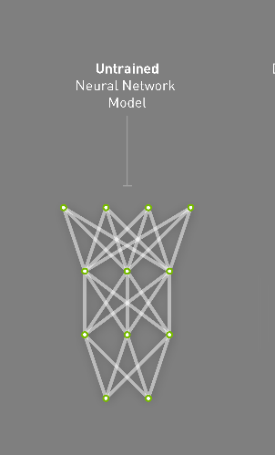
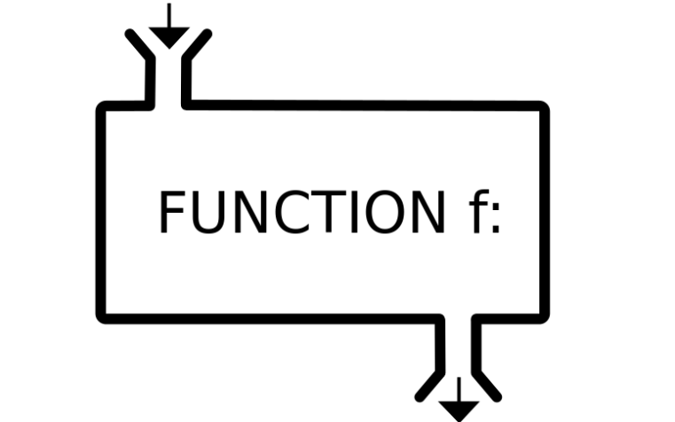
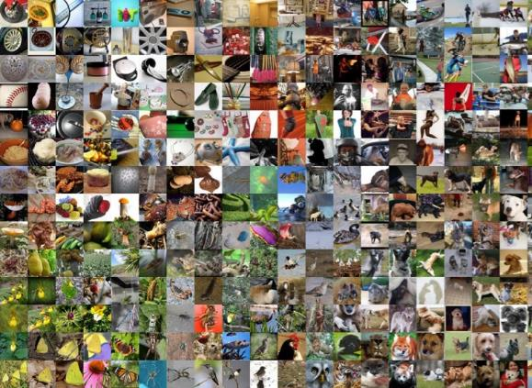
Components of a Model
Model Architecture = deploy.prototxt
Learned Weights = ***.caffemodel
Model
Notes:
In the case of the two detectnet applications, they used the same model architecture and different trained weights, meaning they were trained on different data. This allowed the rest of the application to remain identical.
Before the model is trained, the architecture is defined, usually in a human readable format, in this case using the syntax of the framework, Caffe. From reading that file, we can find out what the input and output shape, of out network is, and then work to build our application to match.
YOU CAN SHOW THEM A DEPLOY FILE BY CLICKING THE LINK “deploy.prototxt” AND TALK THEM THROUGH IDENTIFYING ATTRIBUTES OF THE INPUT AND OUTPUT LAYERS
In the next section of the lab, we’ll see how we swap out the model used within a deep learning application, honoring the constraint that of matching inputs to inputs and outputs to outputs.

Slide 8
Caffe files
*.caffemodel: a binary file containing the weights for the model at the iteration it was saved
*.prototxt: a text file describing the network model and its layers
image_mean.binaryproto: the image mean of the dataset, the model requires this to be subtracted from each image before classifying
Open (cat) static_classify.sh

Slide 9
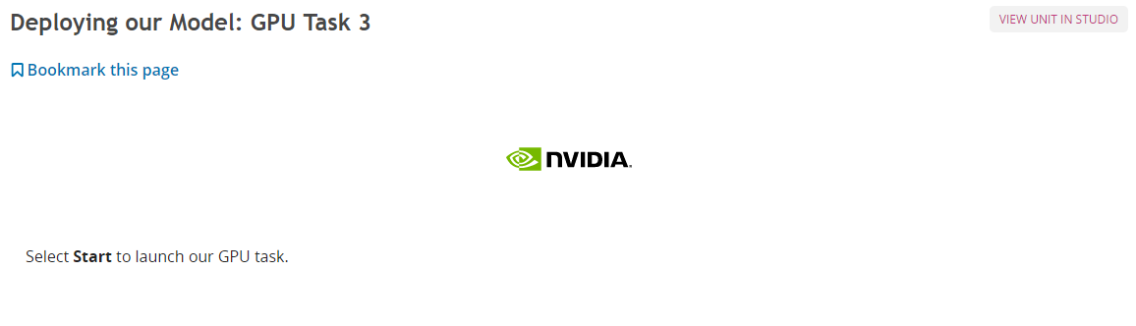
Deploying Our Model: GPU Task 3

